Slide 1



高级数据结构 project-2
Roll Your Own Mini Search Engine
Date: 2019.3.18
第八组：王钟毓 陈宇威 彭子帆

Slide 2
目录
CONTENTS
01
02
03
04
Introduction
Data Structure/
Algorithm Specification
Testing Results
Analysis
and
Comments

Slide 3
01
Introduction

Slide 4









OUR TASKS
01
02
03
04
Run a word count over the Shakespeare set
and try to identify the stop words
1
Create your inverted index over the
Shakespeare set The stop words identified in part (1)
must not be included.
2
3
Write a query program on top of your inverted file index,
which will accept a user-specified word (or phrase) and
return the IDs of the documents that contain that word.
Run tests to show how the thresholds
on query may affect the results.
4

Slide 5
02
Data Structure / Algorithm Specification

Slide 6
Algorithm Specification
Main()
Establishment
Hashtables
Query
Load Dir
Get file
Establish
Inverted-index
match
Key mode

Slide 7
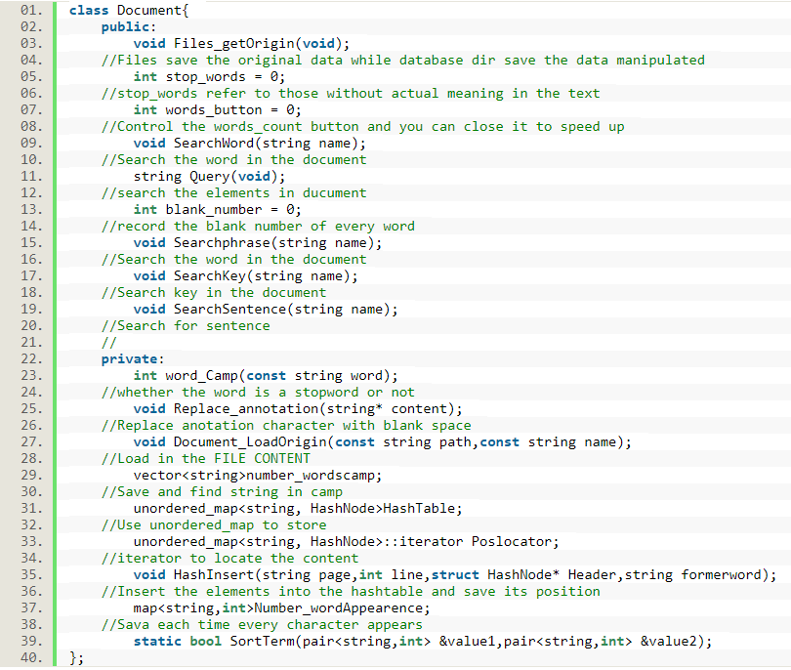
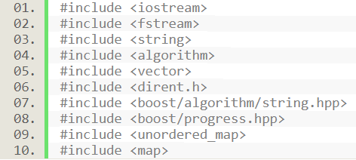
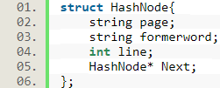
Data Structures
Structures
And
Class
library

Slide 8
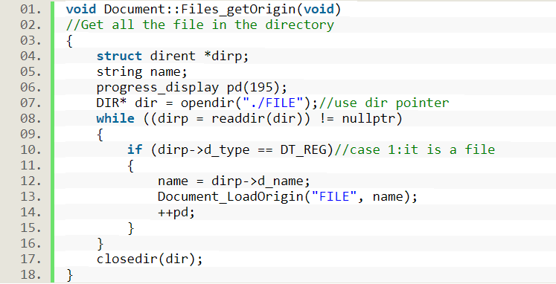
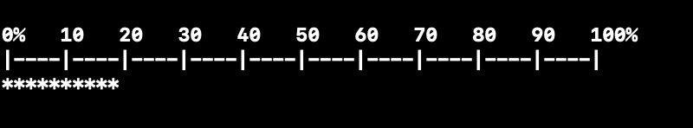
Load dir
1.Open the corresponding directory
2. Load all the file name in the dir
3.progress_display shows the process

Slide 9
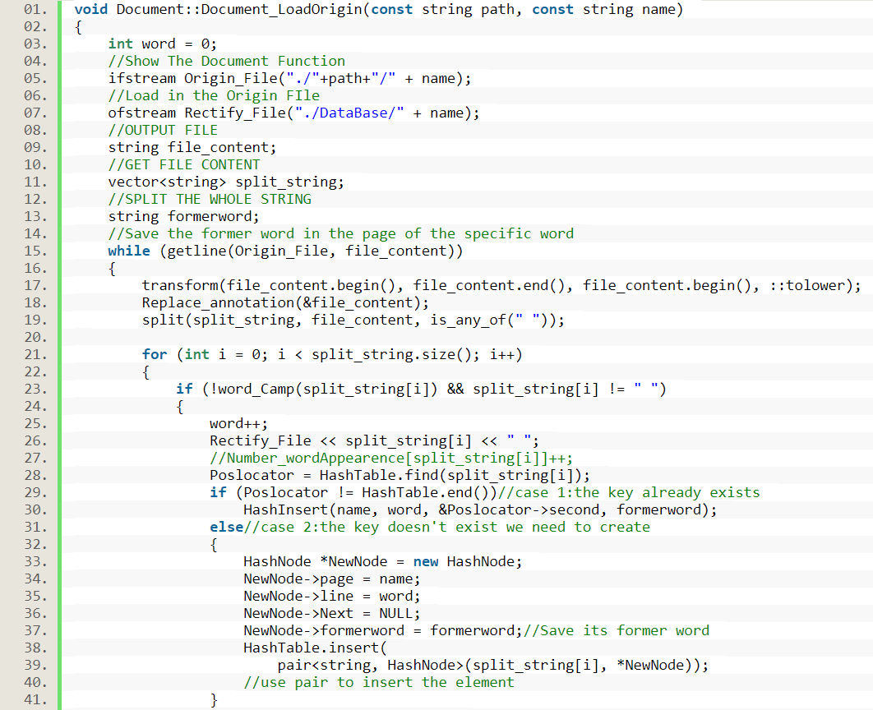
Establish inverted-index
1.Open the specific file
2.Load each line in the file
3.Transform the content into low-letter forms.
1) Delete annotations
2) Delete stop-words
3) Get lower-letter
4.Insert into the unordered-map
1)Find the right position
2)Insert to the struct header

Slide 10
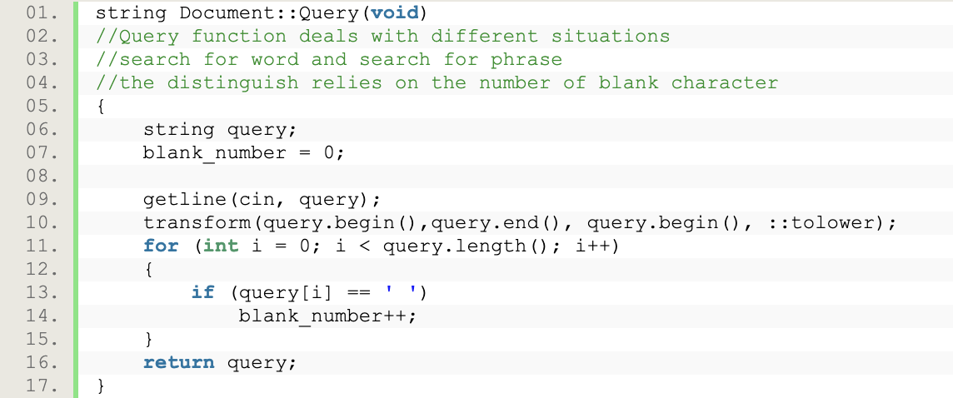
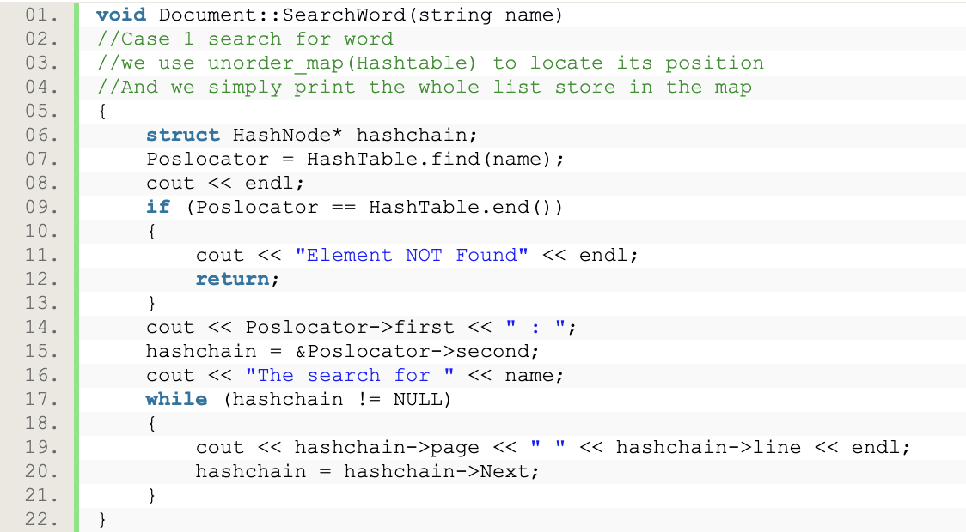
Query && SearchWord
1.Use query to get the string
2.Calculate number of blank
1) zero -> word
2) two -> phrase
3) >three -> sentence
1.Find the position of the word
2.Traverse through the Hashnode

Slide 11
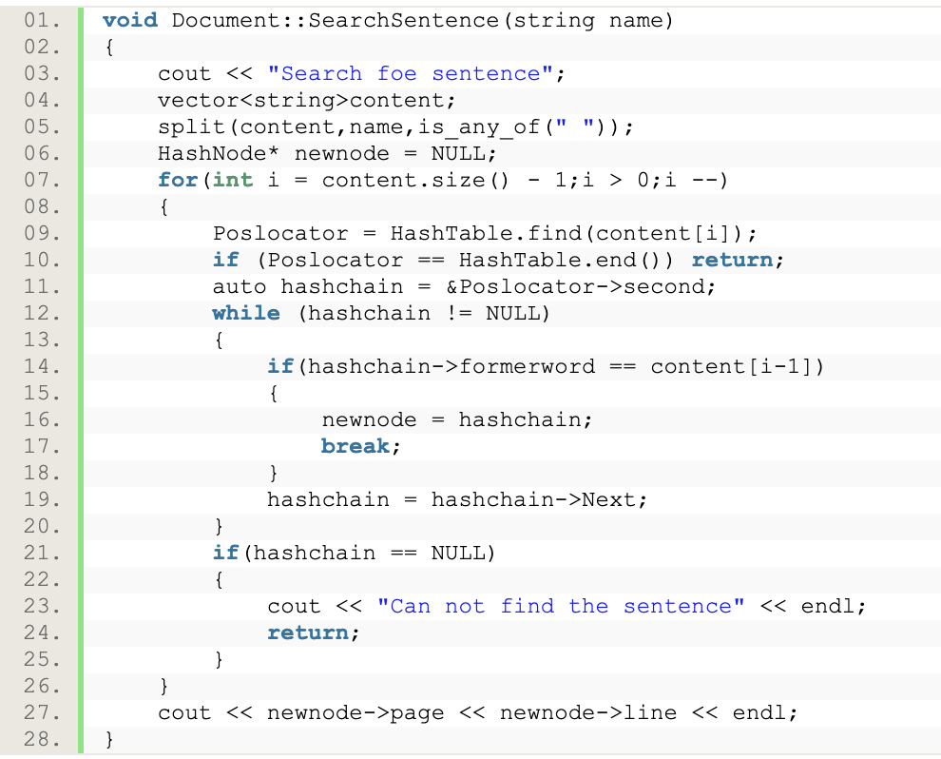
Search sentence
1.Examine from the last word
1)If its former word != string[current - 1]
Not found the correct sentence
2) success in traverse the list
3) Return the header’s location
The phrase is quite similar to the sentence

Slide 12
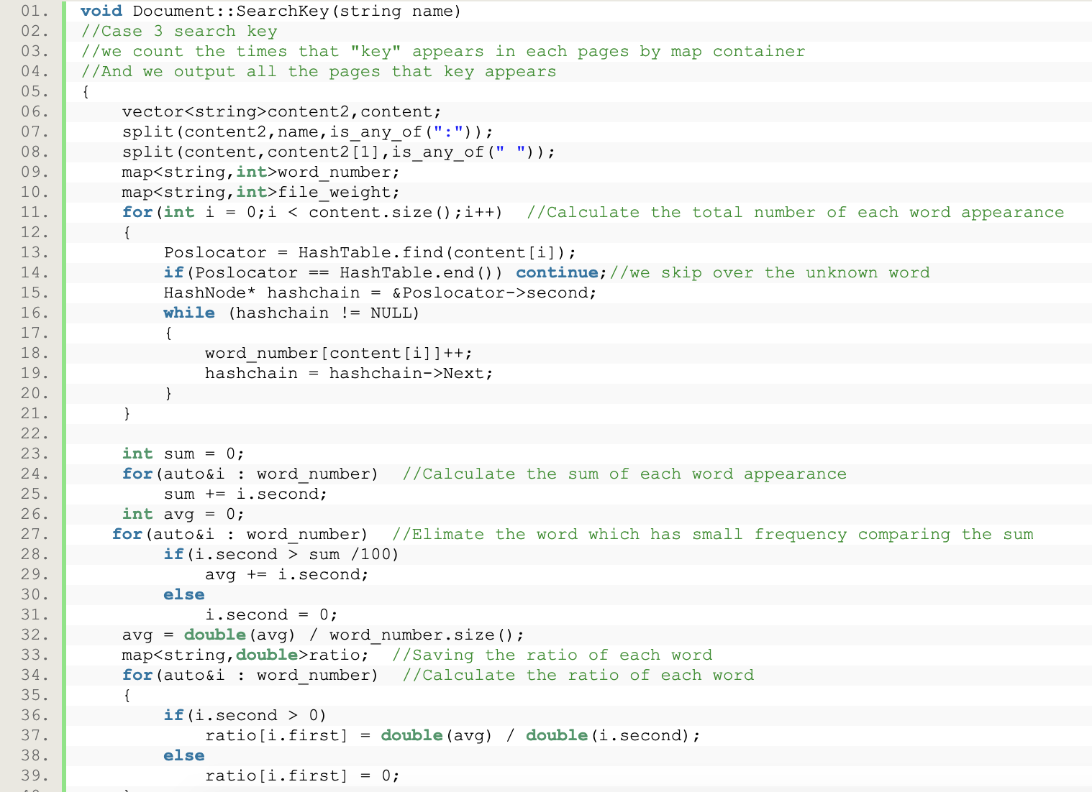
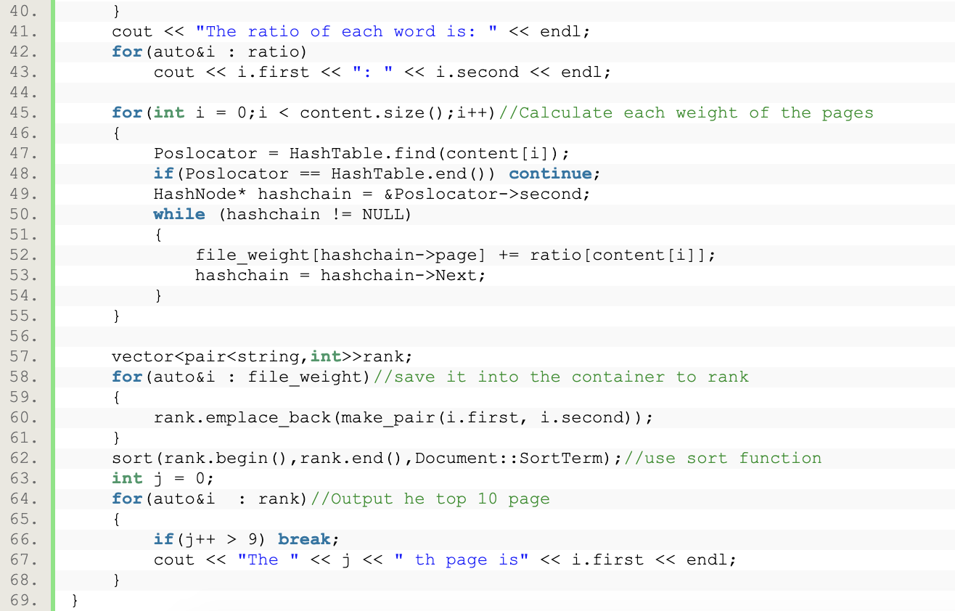
Key mode
1.Sum total frequency of each word
2.Eliminate the word with small frequency
(frequency < total_sum / 100)
3.Calculate the new sum value and average
4.Calculate the ratio of each word
(ratio = average / frequency )
5.Calculate and rank the weight of each paragraph
6.Output the top 10th paragraph

Slide 13
03
Testing Results

Slide 14
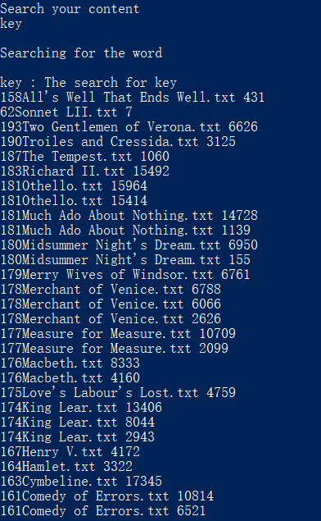
search for a word
The names of files where word “key” appears and its position are output respectively. Files with few key word’s appearance are omitted.

Slide 15
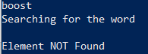
search for a word
If words that never appears are searched for.

Slide 16
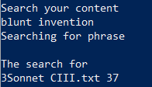
search for a phrase
Search for a specific phrase.
In this case, we only find one “blunt invention”

Slide 17
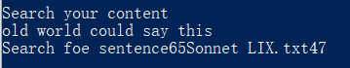
search for a sentence
Or we could search for a whole sentence.

Slide 18
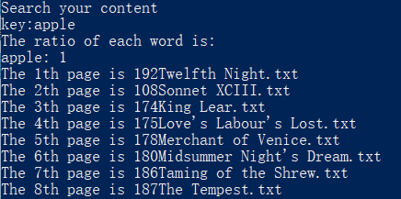
search for key word
Key mode will output the most related files sorted.

Slide 19
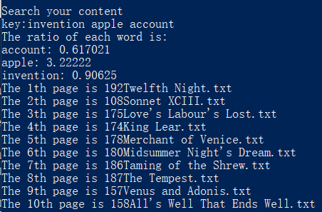
search for key combination
Search for a combination key words, the pages that are most related are output.

Slide 20
04
Analysis and Comments

Slide 21
Analysis
For each English word, insert it to the head of the corresponding list. And the time complexity of find the correct list is O(1). Because there are N words in our data set, it takes O(N) to create the index.
The time complexity of searching is O(M). M is the number of distinct words. In the hash table in the undirected map, there are M distinct words. To find a specific word in the index, a traversal can do the job. And there are M lists representing M distinct words, as a result, it takes O(M) to search a word.
The time complexity of creating the index is O(N).
The time complexity of searching is O(1).

Slide 22
THANKS FOR LISTENING

